Slide 1
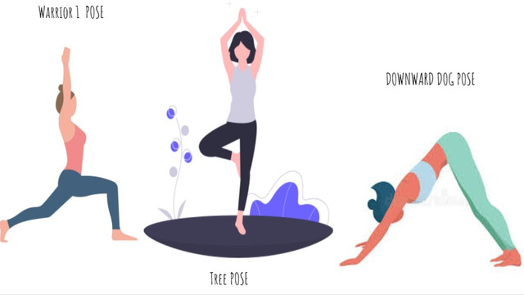
YOGA POSE CLASSIFICATION USING CNN
GRISHMA AV
20191IST0182

Slide 2

Table of Contents
01
02
03
04
OBJECTIVE
PROBLEM STATEMENT AND SOLUTION
CNN (Architecture,Working)
IMPLEMENTATION
RESULT
CONCLUSION

Slide 3
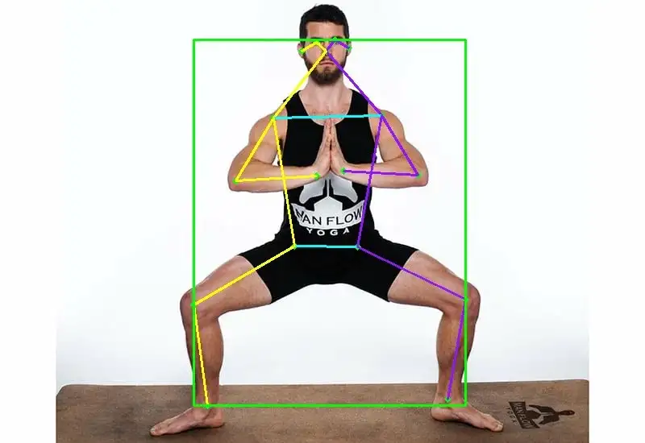
AIM
A pose-detection project using convolutional neural networks by training the CNN model

Slide 4
PROBLEM STATEMENT
Human pose estimation is a deep-rooted problem in computer vision that has exposed many challenges in the past. Analyzing human activities is beneficial in many fields like video surveillance, biometrics, assisted living, at-home health monitoring etc. With our fast-paced lives these days, people usually prefer exercising at home but feel the need of an instructor to evaluate their exercise form. As these resources are not always available, human pose recognition can be used to build a self-instruction exercise system that allows people to learn and practice exercises correctly by themselves.
SOLUTION
This can be achieved by using CNN where we train the cnn model

Slide 5
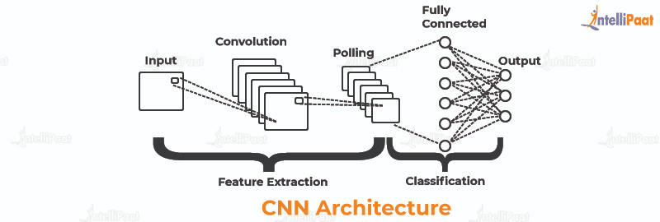
WHAT IS CNN?
A convolutional neural network (CNN or ConvNet) is a network architecture for deep learning that learns directly from data

Slide 6
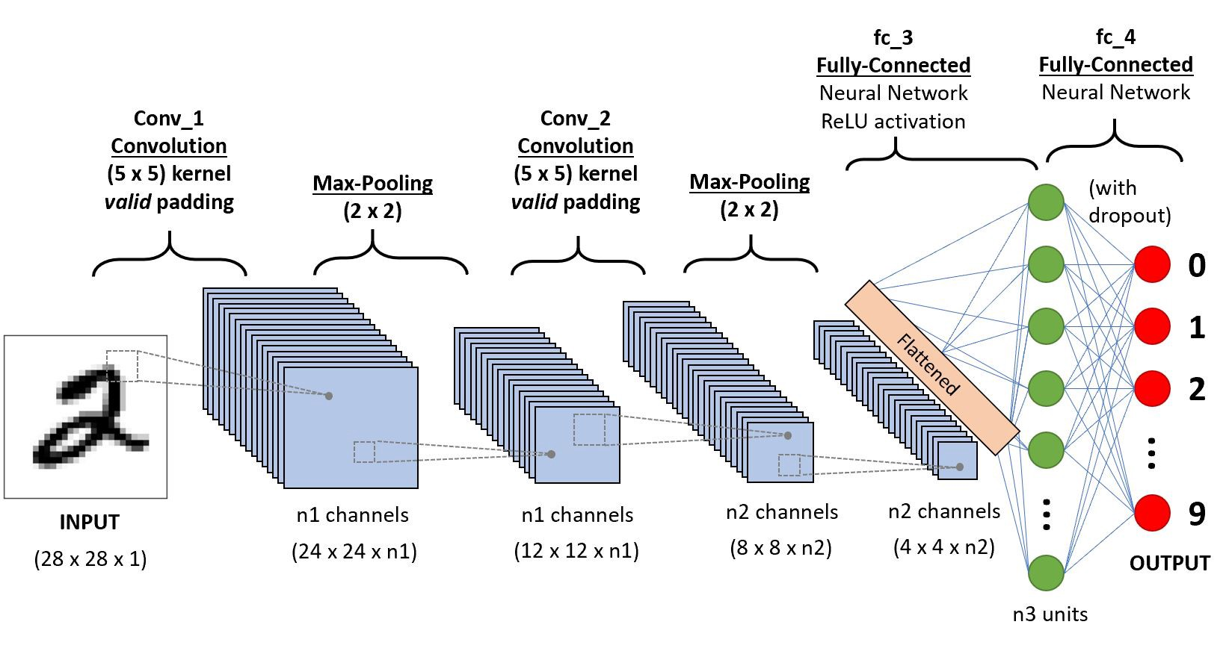
CNN ARCHITECTURE
45K

Slide 7
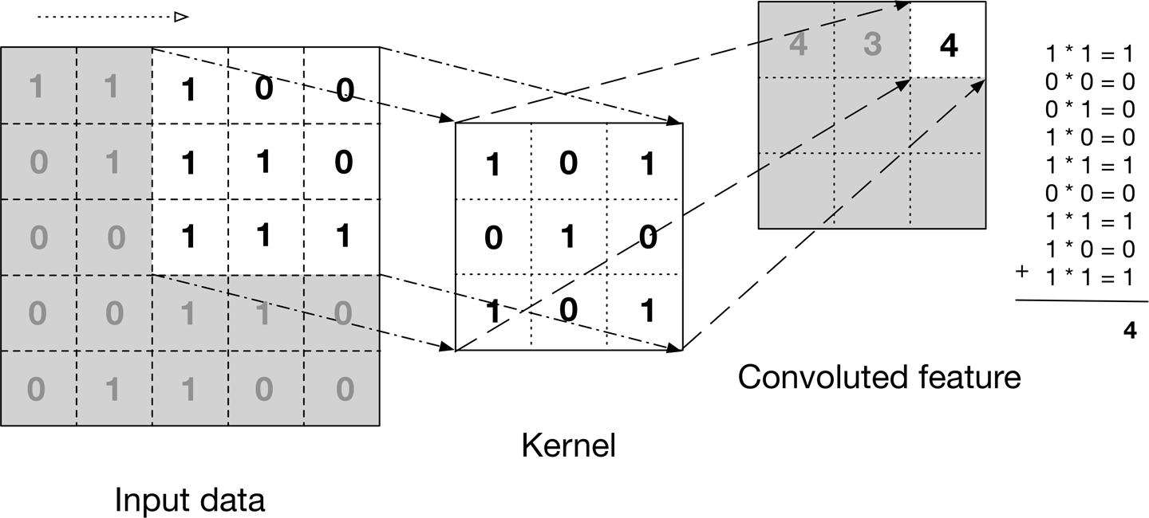
WORKING OF CNN

Slide 8
DATASETS
https://www.kaggle.com/datasets/shrutisaxena/yoga-pose-image-classification-dataset

Slide 9
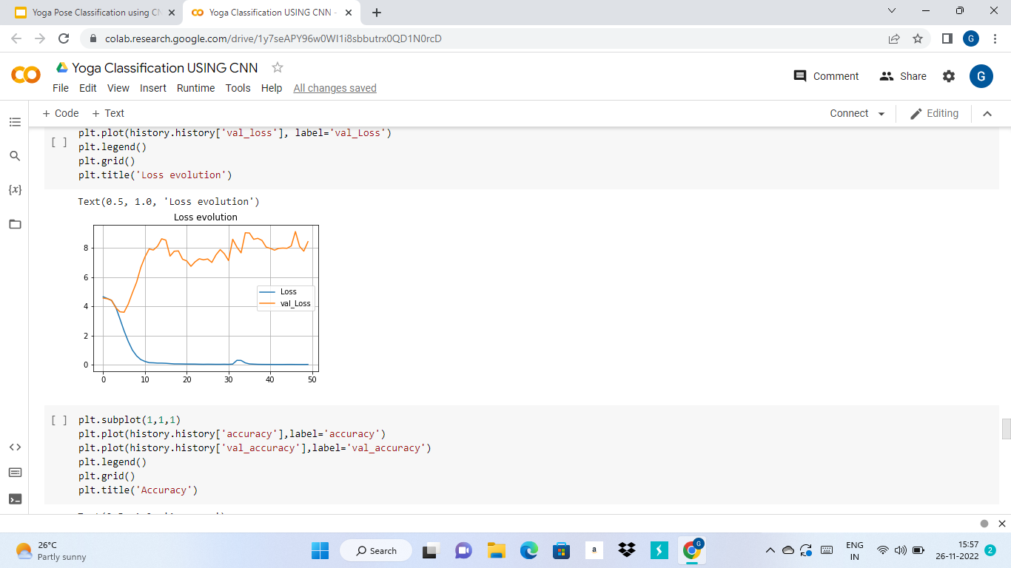

Slide 10
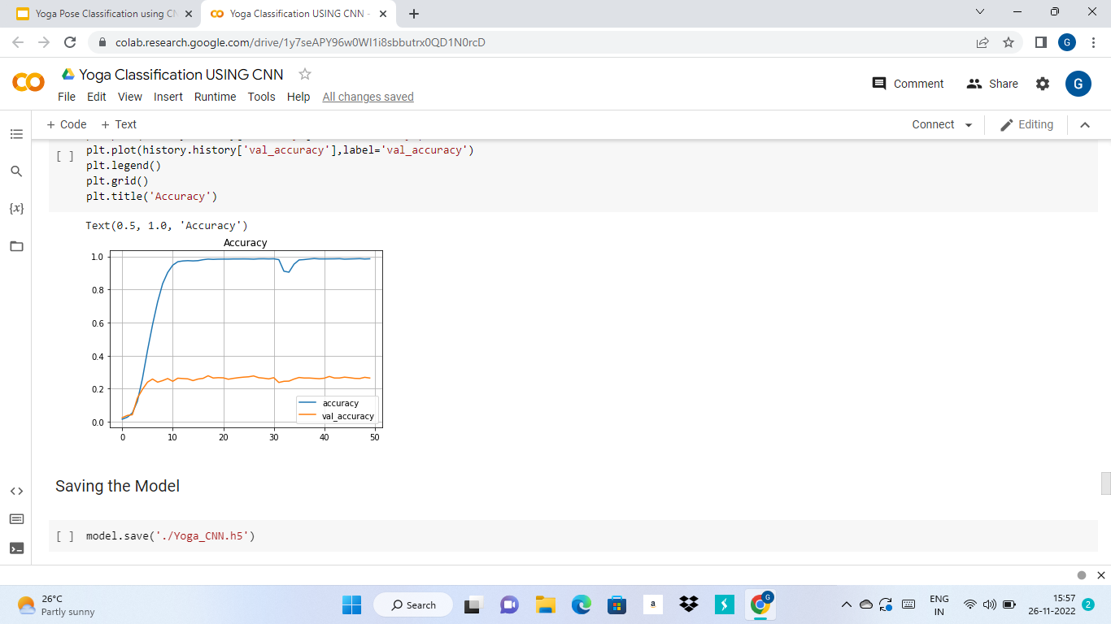

Slide 11
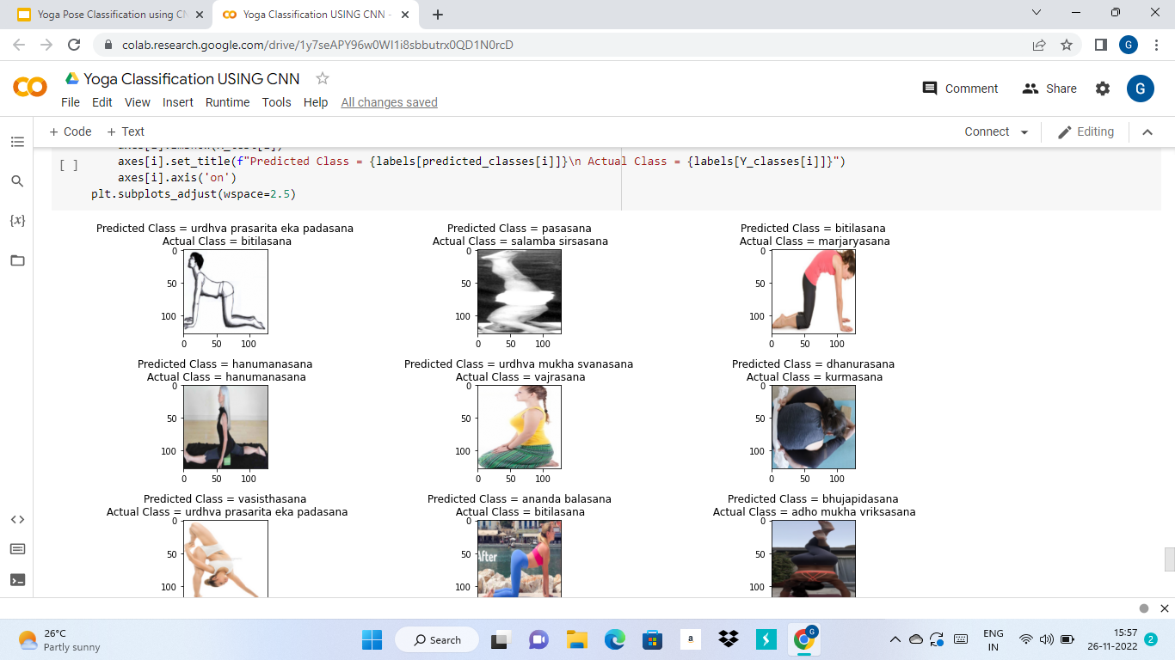

Slide 12
THANKS!
ANY QUESTIONS?

